Slide 1

COLLEGE MANAGEMENT SYSTEM
Team Members:-
Abhishek h (144cs21004)
Prasada (144cs21024)
Chethan (144cs21004)
Deepak (144cs21010)
Dileep (144cs21011)
Karthik (144cs21014)
Vikram (144cs21037)

Slide 2

Student Management System
The Student Management System is a comprehensive platform designed to streamline the administrative tasks associated with managing a school or university. This system provides a centralized hub for storing and accessing student information, tracking academic progress, and facilitating communication between faculty, staff, and students.

Slide 3
Student Registration
Personal Information
Course Selection
Submission and Confirmation
The system allows students to easily register by providing their personal details, such as name, email, date of birth, and gender. This information is securely stored and can be accessed by authorized personnel as needed.
Students can select the course they wish to enroll in, choosing from a range of options including Computer Science, Electronics and Communication, Mechanical Engineering, and Apparel Design and Fabrication Technology.
Once the registration form is filled out, students can submit their application. The system will then process the information and provide a confirmation, allowing students to track the status of their application.

Slide 4
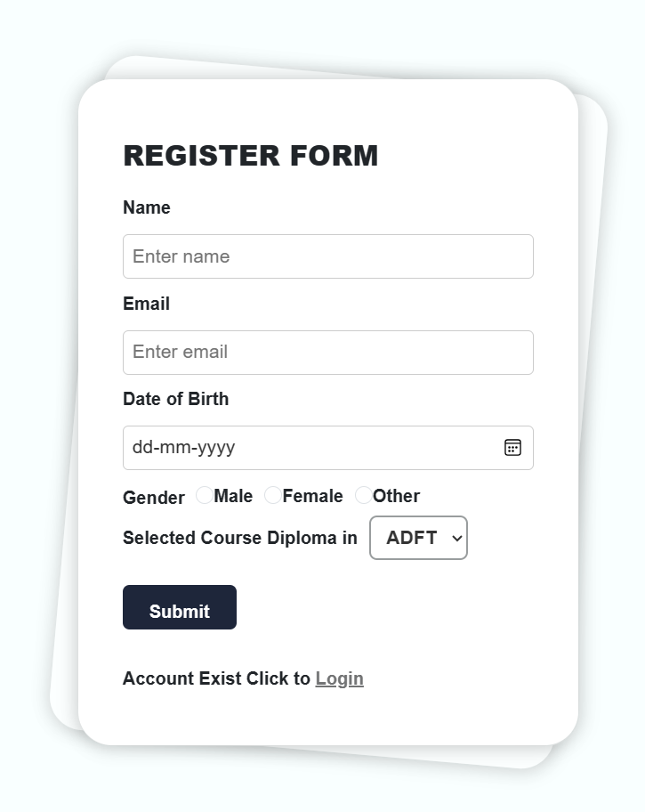
Student Login and Marks Viewing
1
Login
Students can access their academic records by logging into the system using their unique roll number. This secure login process ensures that only authorized individuals can view the student's information.
2
Marks Retrieval
Once logged in, students can view their marks and CGPA (Cumulative Grade Point Average) for each subject they have taken. This feature provides students with a clear understanding of their academic performance and progress.
3
Transparency and Accessibility
The system's user-friendly interface and secure access protocols allow students to conveniently check their marks and stay informed about their academic standing, promoting transparency and accountability in the educational process.

Slide 5
Admin Dashboard
Student Data Management
Marks and CGPA Tracking
The admin dashboard provides a comprehensive view of all student applications, including personal information, course selections, and enrollment status. Administrators can easily access and manage this data to ensure efficient student record-keeping.
Administrators can input and update student marks and CGPA information, ensuring accurate and up-to-date academic records. This feature allows for effective monitoring of student performance and progress.
Reporting and Analytics
User Management
The dashboard offers advanced reporting and analytics capabilities, enabling administrators to generate detailed reports on student enrollment, academic performance, and other key metrics. This data-driven approach supports informed decision-making and strategic planning.
Administrators can manage user accounts, including student and faculty access, ensuring the system's security and integrity. This feature allows for controlled access and the protection of sensitive information.

Slide 6
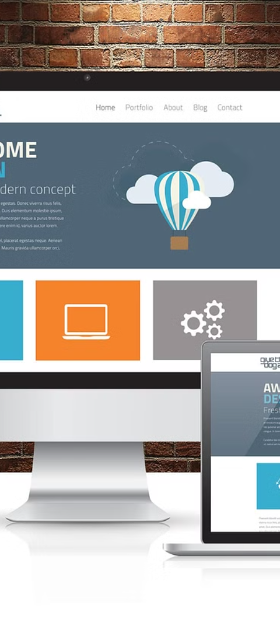
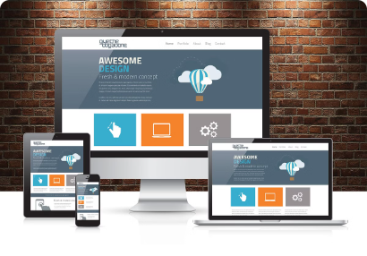
Responsive and Accessible Design
1
Mobile-Friendly Interface
2
Intuitive Navigation
The Student Management System features a responsive design, ensuring that the platform is accessible and user-friendly across a variety of devices, including smartphones and tablets. This allows students and administrators to access the system from anywhere, at any time.
The system's intuitive navigation and clear layout make it easy for users to find the information they need quickly and efficiently. This enhances the overall user experience and promotes engagement with the platform.
3
Accessibility Features
The system incorporates accessibility features, such as support for screen readers and high-contrast modes, to ensure that it is inclusive and usable for individuals with diverse needs and abilities. This commitment to accessibility demonstrates the system's dedication to inclusivity.

Slide 7



Secure and Reliable Infrastructure
Data Security
Reliable Infrastructure
Cloud-Based Deployment
The Student Management System employs robust security measures to protect sensitive student information, including encryption, access controls, and regular backups. This ensures the confidentiality and integrity of the data stored within the system.
The system is built on a scalable and fault-tolerant infrastructure, ensuring high availability and minimal downtime. This guarantees that students and administrators can access the platform consistently, without interruptions or data loss.
The Student Management System is deployed in the cloud, leveraging the benefits of scalability, flexibility, and cost-effectiveness. This cloud-based approach allows for easy maintenance, updates, and seamless integration with other systems as needed.

Slide 8




Collaborative Features
Communication Channels
The system provides various communication channels, such as messaging, announcements, and discussion forums, enabling students, faculty, and staff to collaborate, share information, and stay connected.
Shared Resources
The platform allows for the sharing of educational resources, such as course materials, lecture notes, and assignments, facilitating a collaborative learning environment and promoting knowledge-sharing among students and faculty.
Feedback and Engagement
The system encourages feedback and engagement, enabling students to provide input on their educational experience, course content, and overall satisfaction. This feedback loop helps administrators make informed decisions and continuously improve the system.

Slide 9
Future Enhancements
Feature
Description
Mobile App
Develop a dedicated mobile application for the Student Management System, providing students and administrators with a seamless and on-the-go experience.
Artificial Intelligence
Integrate AI-powered features, such as chatbots and predictive analytics, to enhance the user experience, automate administrative tasks, and provide personalized recommendations.
Integration with External Systems
Facilitate seamless integration with other educational platforms, such as learning management systems and student information systems, to create a more comprehensive and interconnected ecosystem.
Gamification
Incorporate gamification elements, such as badges, leaderboards, and rewards, to foster student engagement, motivation, and a sense of achievement.

Slide 10
THANK YOU

